Slide 1

Types
You can't compare apples to oranges.

Slide 2
Type Systems
A type is
a collection of values
a collection of operations on those values
Java boolean
VALUES: true, false
OPERATIONS: &&, ||, !, ==, &, !, ^
Java int
VALUES: -2³¹…,-1,0,1,… (2³¹-1)
OPERATIONS: +, -, *, /, %, <, >, <=, ==, >=
A type-system is a definition of all types supported by the language. The type system defines the values and the possible operations on those values for every type.
A type-error occurs when an operation is attempted on a value for which the operation is not defined

Slide 3

Type Checking
Languages can be typed:
Statically : The types of all elements are fixed at compile time
Examples are C, C++, Java, Ada
Dynamically : The type of an element can vary at runtime
Examples are Lisp, Scheme, Perl, JavaScript
Languages handle type errors differently
Strongly typed : A language that detects all type errors
Weakly typed : A language that does not detect all type errors

Slide 4
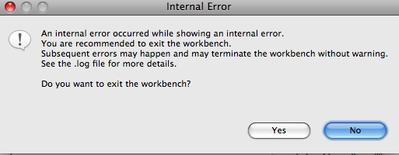
Type error examples
C example
printf("%d", 12);
printf("%s", 12);
Explanation
"%d" means print-as an integer decimal. The corresponding argument is handled as an int. This statement compiles. This statement functions correctly on execution.
"%s" means print-as a string. The corresponding argument is handled as a pointer-to-a-char. This statement compiles. The program crashes on execution.

Slide 5

Primitive data types
Primitive doesn’t mean “backward” or “unsophisticated”.
It does mean “basic” or “atomic". Primitives don't have parts.
How are the values defined within a language?
How are the operations defined within a language?
What are the primitive data types supported in Java, C, JavaScript?

Slide 6
How are values stored?
A ‘word’ is the natural size of numeric data on a CPU.
Most CPU’s use 32-bit words.
Expect that most CPU’s will move toward 64-bit words.
If we assume 32-bit words, the table to the right lists those types that are usually supported by a language.
Type | Bytes
Nibble | ½
Byte | 1
Half-word | 2
Word | 4
Double word | 8
Quad word | 16

Slide 7
Java Primitives
Type | Kind of Value | Memory Used | Values
byte | Integer Number | 1 byte | -128 to 127
short | Integer Number | 2 bytes | -32768 to 32767
int | Integer Number | 4 bytes | -2,147,483,648 to 2,147,483,647
long | Integer Number | 8 bytes | -9,223,372,036,854,775,808 to 9,223,374,036,854,775,808
float | Real Number | 4 bytes | +/- 3.4028… x 10⁺³⁸ to +/- 1.4023… x 0⁻⁴⁵
double | Real Number | 8 bytes | +/- 1.767… x 10⁺³⁰⁸ to +/- 4.940… x 0⁻³²⁴
char | Single character | 2 bytes | 0 to 65535
boolean | Boolean | 1 byte | {true, false}

Slide 8
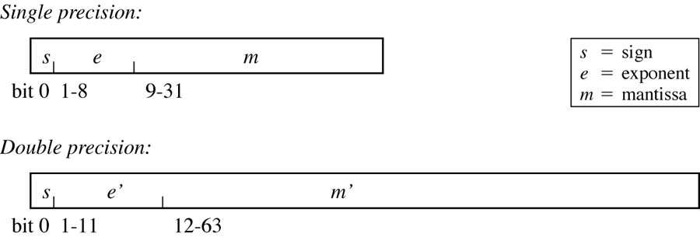
IEEE 754 Floating Point Number Representation
Figure 4.1

Slide 9

Booleans in C
Booleans require only 1 bit but are usually stored as at least one byte.
C and C++ have no boolean data type : use an int instead.
false is defined as “a zero-valued int”
true is defined as “a non-zero-valued int”
Consider the following code
int x=15, y = 0;
if(10 < x < 30) {
y = 2*x;
}
Or the following
while(318) { x = x + 1; }

Slide 10
Operators in C, C++ and Java
Operation | C | C++ | Java
Scope Resolution |  | ::
Member selection (2), subscripting, function call, size | . -> [] () sizeof | . -> [] () sizeof | . NA [] () NA
Unary negation, complement, bitwise complement, increment, decrement, address-of, dereference, allocate, deallocate, cast | - ! ~ ++ -- & * NA NA () | - ! ~ ++ -- & * new delete () | - ! ~ ++ -- NA NA new NA ()
Multiply, divide, modulo | * / % | * / % | * / %
Add, subtract | + - | + - | + -
Left shift, right shift | << >> | << >> | << >>
Less than, less-or-equal, greater-or-equal, greater-than | < <= >= > | < <= >= > | < <= >= >
equal, not-equal | == != | == != | == !=
others omitted |  |  | instanceof
sequencing | , | , | ,

Slide 11
Operator Overloading
An operator is overloaded when its meaning varies depending on the types of its operands or arguments or results.
What is the type of the expression "x = y + z" in a Java program?
int y = 3, z = 5;
x = y + z;
float y=3, z=5;
x = y + z;
double y=3, z=5;
x = y + z;
String y=“3”, z=“5”;
x = y + z;

Slide 12
Operator overloading
C++ allows programmers to overload the built-in operators.
class Fraction {
public:
Fraction(int n=0, int d=1) {
num = n;
denom = d;
}
Fraction add(const Fraction &that) {
Fraction result;
result.num = num*that->denom + that->num*denom;
result.denom = denom * that->denom;
return result;
}
private:
int num, denom;
}
Fraction f1(3,5);
Fraction f2(2,7);
Fraction f3 = f1.add(f2);

Slide 13
Operator Overloading
C++ allows programmers to overload the built-in operators.
class Fraction {
public:
Fraction(int n=0, int d=1) {
num = n;
denom = d;
}
Fraction operator +(const Fraction &that) {
Fraction result;
result.num = num*that->denom + that->num*denom;
result.denom = denom * that->denom;
return result;
}
private:
int num, denom;
}
Fraction f1(3,5);
Fraction f2(2,7);
Fraction f3 = f1+f2;

Slide 14
Coercion / Casting
Consider the expression
double x = 3;
What is the meaning of the assignment?
What is the type of 3? How many bytes does it occupy in memory?
What is the type of 'x'? How many bytes does it occupy in memory?
Assignment really means "copy the bytes on the right to the address given on the left"
If the types aren't exact(i.e. the memory requirements differ) one of following must occur:
Coercion : the type of an expression is automatically changed to enable the assignment.
Casting : the type of an expression is explicitly changed by the programmer to enable the assignment.

Slide 15
Coercion / Casting
Coercion is a widening operation.
The footprint is automatically made bigger.
No information is lost (usually)
double x = (can you type an int that isn't a double?)
Casting is a narrowing operation.
The footprint is manually made smaller.
Information may be lost
int x = (int)(can you type a double that isn't an int?)
int
double
int
double

Slide 16

Coercion / Casting
Imagine life without coercion (remember that for assignment, the types of the left and right hand sides must match exactly)
Consider the following example (this wouldn't work)
double x = 3;
Would have to write as
double x = (double)3;
Java does allow data to be lost via coercion
long result=9223371836854775807L;
float x = result;

Slide 17
Coercion rules
Real languages have complex rules for coercions.
Rules for Java on the arithmetic binary operators:
If either operand is of type double, convert the other to double and compute a double result
Otherwise, if either operand is of type float, convert the other to float and compute a float result
Otherwise, if either operand is of type long, convert the other to long and compute a long result
Otherwise, convert both operands to int and compute an int result
Consider
int x = 3;
double y = 1.5;
double z = 2 * y + (x / 2 – 0.5f );

Slide 18

Short Circuits
In Java/C/C++, the || and && operators use short-circuit evaluation
Expressions with && and || are evaluated left to right. Evaluation stops as soon as the correct boolean value of the entire expression is known.
Expressions involving & and | work identically to those involving && and || with the exception that there is no short-circuit evaluation.
In Ada, non-short-circuit is indicated by the words “and” and “or”. Short circuit is indicated by “and then” and “or else”

Slide 19
Java Example
int x = 2;
int y = 1;
System.out.println(x | y);
boolean x = true;
boolean y = false;
System.out.println(x | y);
15.22.1 Integer Bitwise Operators &, ^, and |
When both operands of an operator &, ^, or | are of primitive integral type, binary numeric promotion is first performed on the operands. The type of the bitwise operator expression is the promoted type of the operands.
For &, the result value is the bitwise AND of the operand values.
For ^, the result value is the bitwise exclusive OR of the operand values.
For |, the result value is the bitwise inclusive OR of the operand values.
For example, the result of the expression 0xff00 & 0xf0f0 is 0xf000. The result of 0xff00 ^ 0xf0f0 is 0x0ff0.The result of 0xff00 | 0xf0f0 is 0xfff0.
15.22.2 Boolean Logical Operators &, ^, and |
When both operands of a &, ^, or | operator are of type boolean, then the type of the bitwise operator expression is boolean.
For &, the result value is true if both operand values are true; otherwise, the result is false.
For ^, the result value is true if the operand values are different; otherwise, the result is false.
For |, the result value is false if both operand values are false; otherwise, the result is true.

Slide 20
Comparison
Operation | Java | VB.Net | Ada
AND (non-short circuit) | & | And | and
OR (non-short circuit) | | | Or | or
AND (short circuit) | && | AndAlso | and then
OR (short circuit) | || | OrElse | or else

Slide 21
Enumerated Types
Enumerated type: an abstract data type, each of whose values take on exactly one of a finite set of identifiers chosen by the programmer.
Enumerated types are typically used for categorical variables which do not have any numerical order.
Enumerated types are often implemented using integers (each identifier has a distinct integer value).

Slide 22

Enumerated types : Example
Problem: Write Java code that keeps track of four directions (north, south, east, west). The code must model that notion that there are 4 and only 4 directions and that there is a direction type.

Slide 23

EnumeratIONS
Define an interface
Four attributes
Each final and public
Does this meet our goals
Exactly four directions?
Direction is a data type?
interface DirectionConstants {
public final static int NORTH = 0;
public final static int SOUTH = 1;
public final static int EAST = 2;
public final static int WEST = 3;
}
public class MovingObject implements DirectionConstants {
private double speed;
private int direction = NORTH;
public void setDirection(int direction) {
this.direction = direction;
}
public boolean isHeadedNorth() {
return this.direction == SOUTH;
}
}

Slide 24
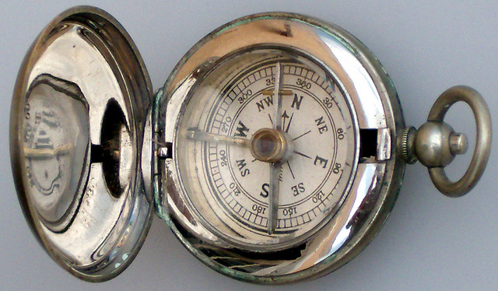
EnumeratIONS
class Direction() { }
interface DirectionConstants {
final static Direction NORTH = new Direction();
final static Direction SOUTH = new Direction();
final static Direction EAST = new Direction();
final static Direction WEST = new Direction();
}
public class MovingObject implements
DirectionConstants {
private double speed;
private Direction direction = NORTH;
public void setDirection(Direction direction) {
this.direction = direction;
}
public boolean isHeadedNorth() {
return this.direction == NORTH;
}
}
Define a class
Four attributes
Each final and public
Does this meet our goals
Exactly four directions?
Direction is a data type?

Slide 25

EnumeratIONS
public final class Direction {
private Direction() { }
final static Direction NORTH = new Direction();
final static Direction SOUTH = new Direction();
final static Direction EAST = new Direction();
final static Direction WEST = new Direction();
}
public class MovingObject {
private double speed;
private Direction direction = Direction.NORTH;
public void setDirection(Direction direction) {
this.direction = direction;
}
public boolean isHeadedNorth() {
return this.direction == Direction.NORTH;
}
}
Define a class
Four attributes
Each final and public
Does this meet our goals
Exactly four directions?
Direction is a data type?

Slide 26
Enumerations
An enumerated type defines
A type
Allowed instances of that type
Supported by C, Java and many others
enum Direction {NORTH, SOUTH, EAST, WEST};
Direction d = Direction.NORTH;

Slide 27
Enumerations
In Java, enumerations possess two methods
Ordinal returns the numeric index of the enumerated value
Name returns the name of the instance as a String
enum Direction {NORTH, SOUTH, EAST, WEST};
Direction d = Direction.NORTH;
int x = d.ordinal();
String name = d.name();

Slide 28
Enumerations
In C, enumerations are ints. They are type weak.
enum {MON, TUE, WED, THU, FRI} weekday;
weekday = MON;
weekday = TUE;
for(weekday = MON; weekday <= FRI; weekday++) {
printf(“%d\n”, weekday);
}
weekday = 518; // this is bad but compiles!

Slide 29

Pointers
A pointer stores a reference to something.
The type of a pointer is POINTER-TO-[SOME_TYPE]
The value of a pointer is a memory address.
The size of a pointer is a word
A value of SOME_TYPE will be found in the memory address stored as the pointer value
Consider
Let's let x be a pointer-to-an-int
Let's let y be 3
Let's let z be 6
Make x point to y
What is the value of x?
What is the value of the thing referred to by x?
Make x point to z
What is the value of x?
What is the value of the thing referred to by x?

Slide 30

Pointers
Since pointers refer to something, the type of the thing they refer to is part of the pointer type. There is not really "just a pointer". You might say that
X is a pointer-to-an-int
Y is a pointer-to-a-float
Z is a pointer-to-a-node-structure
In C
the pointer type is denoted by an asterisk (*). The asterisk follows the type of thing that is pointed to.
int* ptr; // ptr is a variable. It refers to an int.
float* a; // a is a variable. It refers to a float
void* v; // v is a pointer-to-something. It's as generic as you can get.
The address-of operator produces the memory location of a variable.
&x : the memory location of x.

Slide 31
Pointers
Two pointer operations in C
assignment : "Make x point to y".
dereferencing : "What is the value of the thing x points to"
Rules
Assignment : If the lhs is a pointer, the right-hand-side must be a memory location of the correct type.
int a = 3;
int b = 5;
int* ptr;
ptr = &a;
ptr = &b;
Dereferencing : denoted by an asterisk that precedes a pointer. Produces the value stored at the pointers memory location.
a = *ptr;

Slide 32
Pointers
When dereferencing a pointer, the dereferenced pointer is assignable.
int a = 3;
int b = 5;
int* ptr;
ptr = &a;
ptr = &b;
a = *ptr;
*ptr = 12;

Slide 33
Pointers in C
int x, y, *z;
x = 10;
y = 50;
z = &y;
x = y + *z;
*z = x * *z;
z = &x;
x = y + *z;
z++;
x = y + *z;
Address | Contents
0999
1000 | X
1001
1002
1003
1004 | Y
1005
1006
1007
1008 | Z
1009
1010
1011
1012

Slide 34

Pointer Example in C
value next
head
1
3
5
7
struct Node {
int value;
struct Node *next;
}
struct Node *head;
struct Node *find(int x) {
struct Node *p = head;
while(p != NULL && p->value != x) {
p = p->next;
}
return p;
}
What are the types of the expressions
head
*head
head->value
head->next
*(head->next)

Slide 35

Pointer Arithmetic
C supports addition and subtraction on pointers. In the expression "a + b" if either operand is a pointer and the other operand is a number. Let p be the pointer and n be the number. The result of the operation is a memory location and is given as
p + sizeof(thing-pointed-to-by-p)*n;
Examples:
char *p;
…
char *p1 = (p + 1);
char *p2 = (p + 2);
int *q;
…
int *q1 = (q + 1);
int *q2 = (q + 2);

Slide 36
Pointer Arithmetic
C supports addition and subtraction on pointers. In the expression "a - b" if both operands are pointers to the same data type then the result of the operation is number given as
the difference of a and b divided by the sizeof the element referred to by a and b.
Examples:
char *p1;
char * p2;
…
int pDiff = p1 – p2;
int *q1;
int *q2;
…
int qDiff = q1 – q2;

Slide 37
Dynamic Data
Two basic memory operations with dynamic data
Object creation : allocates heap storage for an element. Heap storage exists for the duration of a program unless explicitly freed.
Object destruction : returns heap storage to the OS for later use.
Example in C
void *malloc(int number_of_bytes)
allocates a contiguous amount of the specified amount of memory and returns the address of the first byte.
void free(void *p)
de-allocates the memory referred to by pointer p. Pointer p must have previously been returned by a call to malloc.

Slide 38
Pointer Example in C
value next
head
1
3
5
7
struct Node {
int value;
struct Node *next;
}
struct Node *head;
// Code fragment
void insert(int v) {
struct Node *p = head;
while( p->next != NULL ) {
p = p->next;
}
p->next = (struct Node*)malloc(sizeof (struct Node));
p->next->value = v;
p->next->next = NULL;
}

Slide 39
Dynamic Data in C
// Illustrates creation of dynamic data
// Also illustrates pointer arithmetic…
char *createHelloString() {
char *str = (char*)malloc(6 * sizeof(char));
*str = ‘h’;
*(str+1) = ‘e’;
*(str+2) = ‘l’;
*(str+3) = ‘l’;
*(str+4) = ‘0’;
*(str+5) = (char)0;
return str;
}

Slide 40
Pointer related errors
Dangling pointer : a pointer that points to something other than what it should.
Memory leak : when memory has been allocated to a program but the memory is unreachable.
Node *n1 = (Node*)malloc(sizeof(Node));
Node *n2 = (Node*)malloc(sizeof(Node));
free(n2);
n1 = n2;

Slide 41
Pointers : Allows Recursive Data
C does not have Objects. Rather it has structures. A structure is essentially an object without methods. A collection of data.
Consider the following recursive structure. What is the memory footprint?
struct Node {
int value;
struct Node next;
}
Consider the following structure. What is the memory footprint?
struct Node {
int value;
struct Node *next;
}

Slide 42
Pointers : Efficient Data management
Pointers can be used to efficiently pass lots of data!
C always uses pass by value (copy the parameter to the method)
When a pointer is passed to a function, how much data is “copied”?
char *str = (char *)malloc(5000 * sizeof(char));
int x = myStringFunction(str);

Slide 43
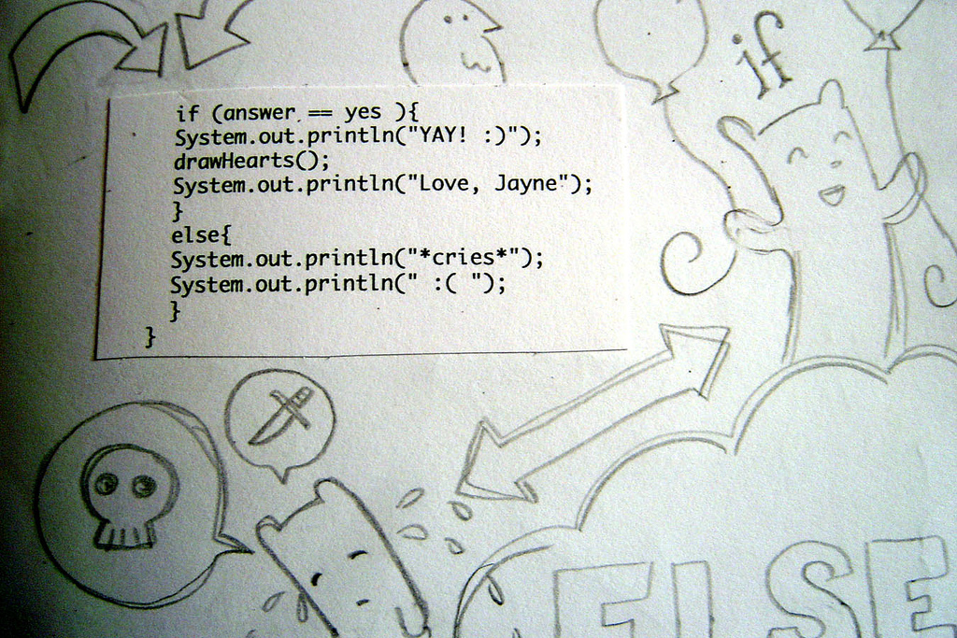
Pointers and Java
Does Java support the pointer data-type?
What does the following mean in Java?
List<String> strings = new ArrayList<>(500);
…
int count = stringsThatStartWith(strings, "A");
How are objects deleted in Java?
delete strings;
free strings;

Slide 44
Arrays
Arrays: a structure that holds a sequence of same-typed elements
Design Issues
What are legal types for subscripts?
Are subscripts range-checked?
When does allocation occur?
How many subscripts are allowed?
Can arrays be initialized when allocated?
Are slices allowed?

Slide 45
Subscript Types
Which of the following is possibly legal in Java assuming that values is an array of Objects and it has a length of at least 2?
values[true]
values[0.0]
values[0]
values[0L]
values[0f]
values["0"]
Language | Allowed subscripts
Java | Int
Pascal | Int, Boolean, Enumerations
Ada | Int, Boolean, Enumerations
Perl | Int, String
JavaScript | Anything

Slide 46
Bounds
Subscript bounds can be computed either statically or dynamically
static: the subscript ranges must be known at compile time
dynamic: the ranges must be known at run-time
Language | lower-bound | upper-bound
C | 0 | static
FORTRAN I/II/IV | 1 | static
FORTRAN 77/90 | defaults to 1 but can be changed | dynamic
Java/C++ | 0 | dynamic
Most Others | dynamic | dynamic

Slide 47
Range Checking
Does the language check for valid index values as the program executes or when the program is compiled?
int[] data = new int[10];
for(int i=0; i < 100; i++) {
System.out.println(data[i]);
}

Slide 48
Allocation
Allocation is concerned with when memory is reserved for an array. Layout is concerned with how an array is arranged in memory.
Static allocation : memory is reserved by the compiler (the compiler must know how much memory to reserve)
Dynamic allocation : memory is reserved as the program executes (the compiler doesn't need to know how much memory to reserve)
What are the values of the array elements after allocation?
// Java examples
int[] a = new int[10];
float[][][] b = new float[3][4][2];
char[][] c = new char[4][3];
Object[][] d = new Object[8];
// C examples
int a[10];
float b[3][4][2];
char *c = (char*)malloc(12*sizeof(char));

Slide 49
Array Layout
int A = new int[3][4]
Address | Contents
base | A[0][0]
base+sizeof(int) | A[0][1]
base+2*sizeof(int) | A[0][2]
base+3*sizeof(int) | A[0][3]
base+4*sizeof(int) | A[1][0]
base+5*sizeof(int) | A[1][1]
base+6*sizeof(int) | A[1][2]
base+7*sizeof(int) | A[1][3]
base+8*sizeof(int) | A[2][0]
base+9*sizeof(int) | A[2][1]
base+10*sizeof(int) | A[2][2]
base+11*sizeof(int) | A[2][3]
base+12*sizeof(int) | ???
Address | Contents
base | A[0][0]
base+sizeof(int) | A[1][0]
base+2*sizeof(int) | A[2][0]
base+3*sizeof(int) | A[0][1]
base+4*sizeof(int) | A[1][1]
base+5*sizeof(int) | A[2][1]
base+6*sizeof(int) | A[0][2]
base+7*sizeof(int) | A[1][2]
base+8*sizeof(int) | A[2][2]
base+9*sizeof(int) | A[0][3]
base+10*sizeof(int) | A[1][3]
base+11*sizeof(int) | A[2][3]
base+12*sizeof(int) | ???
A[0][0] | A[0][1] | A[0][2] | A[0][3]
A[1][0] | A[1][1] | A[1][2] | A[1][3]
A[2][0] | A[2][1] | A[2][2] | A[2][3]
Logical view of array A
Row major layout
Column major layout

Slide 50
Array Layout
int A = new int[3][4]
Address | Contents
base | A[0][0]
base+sizeof(int) | A[0][1]
base+2*sizeof(int) | A[0][2]
base+3*sizeof(int) | A[0][3]
base+4*sizeof(int) | A[1][0]
base+5*sizeof(int) | A[1][1]
base+6*sizeof(int) | A[1][2]
base+7*sizeof(int) | A[1][3]
base+8*sizeof(int) | A[2][0]
base+9*sizeof(int) | A[2][1]
base+10*sizeof(int) | A[2][2]
base+11*sizeof(int) | A[2][3]
base+12*sizeof(int) | ???
int A = new int[3][4]
int i = (int)(Math.random()*3);
int j = (int)(Math.random()*4);
int z = A[i][j];
A[0][0] | A[0][1] | A[0][2] | A[0][3]
A[1][0] | A[1][1] | A[1][2] | A[1][3]
A[2][0] | A[2][1] | A[2][2] | A[2][3]
How/When can this value be obtained?
Logical view of array A
A[i][j] = contents of memory location
(base + i*num_cols + j)
Row major layout

Slide 51
Array Layout
int A = new int[3][4]
Address | Contents
base | A[0][0]
base+sizeof(int) | A[1][0]
base+2*sizeof(int) | A[2][0]
base+3*sizeof(int) | A[0][1]
base+4*sizeof(int) | A[1][1]
base+5*sizeof(int) | A[2][1]
base+6*sizeof(int) | A[0][2]
base+7*sizeof(int) | A[1][2]
base+8*sizeof(int) | A[2][2]
base+9*sizeof(int) | A[0][3]
base+10*sizeof(int) | A[1][3]
base+11*sizeof(int) | A[2][3]
base+12*sizeof(int) | ???
int A = new int[3][4]
int i = (int)(Math.random()*3);
int j = (int)(Math.random()*4);
int z = A[i][j];
A[0][0] | A[0][1] | A[0][2] | A[0][3]
A[1][0] | A[1][1] | A[1][2] | A[1][3]
A[2][0] | A[2][1] | A[2][2] | A[2][3]
How/When can this value be obtained?
Logical view of array A
A[i][j] = contents of memory location
(base + i + j*num_rows)
Column major layout

Slide 52
Examples
Arrays are static in Ada/Pascal/C : the below is Ada
When allocating arrays, there must be a “doping vector”.
a : array(-4..5) of INTEGER;
c : array(1..4, 0..2) of FLOAT;
s : array(1..40) of CHARACTER;
4 | int | 10 | A[0] | A[1] | … | A[9]
element size / element type / size of array
2 | Char | 4 | 3 | A[0][0] | … | A[3][2]
element size / element type / rows / cols

Slide 53
Arrays and Pointers
In C there is a strong correspondence between pointers and arrays.
The lvalue of an array is the memory address of it’s first element.
int strlen(char *str) {
int result = 0;
while(str[result++] != 0);
return result-1;
}
int strlen(char *str) {
char *str2 = str;
while( *(str2++) );
return (int)(str2-str-1);
}

Slide 54
Multidimensional Arrays and “Sections”
How many dimensions are typically supported?
Most languages support 7 or 8
Rarely need dimensions over 3
Sections : a way to process 'parts' of an array
Fortran 90 has built-in support for accessing sections
Example : Given a 2D array of ints in Java, create a sub-array containing even-numbered row, col pair

Slide 55
Fortran 90 Arrays : Case Study
The dimension of an array may be specified as shown below:
REAL, DIMENSION(10) :: A, B
INTEGER, DIMENSION(0:9) :: C
REAL, DIMENSION(-3:2) :: D
Arrays A, B and C are each of length 10. The indices of A and B range from 1 to 10. The indices of C range from 0 to 9. Array D is of length 6 and the indices range from -3 to 2.
Arrays may be initialized using shorthand notation
A = (/ 1, 2, 3, 4, 5, 6, 7, 8, 9, 10 /)
A = (/ (I, I = 1, 10) /)

Slide 56
Fortran 90 Arrays : Case Study
Can assign arrays if the dimensions are the same.
REAL, DIMENSION(10) :: A, B
A = B
Operators may be applied to arrays and not just numbers
A = A + B
A = A * 2
Multidimensional arrays are supported
REAL, DIMENSION(2, 3) :: A
INTEGER, DIMENSION(10,20,3) :: B

Slide 57
Fortran 90 Arrays : Case Study
A slice is denoted using the notation
<low> : <high> : <step>
Access all elements having indices that range from low to high in increments of step. If low is not provided, it defaults to the lowest possible. If high is not provided, it defaults to the highest possible. If step is not provided, it defaults to 1
Assuming the following declarations
REAL, DIMENSION(0:5) :: c
INTEGER, DIMENSION(5, 5) :: d
Then we can access the following slices
c(:) ! whole array
c(:3) ! elements 0,1,2,3
c(::2) ! elements 0,2 and 4
d(:,4) ! all elements of the fourth column.
d(::2,:) ! all elements of every other row

Slide 58
Fortran 90 Arrays : Case Study
Example
REAL, DIMENSION(100) :: a, b, c
REAL : d(10,10) = 0.0
b = 2*a+4
a = 2.0
c = b*a
c = d
Example
REAL, DIMENSION(10) :: alpha, beta
REAL :: gamma(20)
alpha(1:5) = 2.0
gamma(11:20) = beta

Slide 59

Records
Record : an aggregation of related data into a single “thing".
type two_chars = packed array [1..2] of char;
type element = record
name : two_chars;
atomic_number : integer;
atomic_weight : real;
metallic : Boolean
end;
typedef struct element {
char name[2];
int atomic_number;
double atomic_weight;
char metallic;
} element;
Pascal Example
C Example

Slide 60
Record Layout
struct element {
char name[2];
int atomic_number;
double atomic_weight;
char metallic;
}
How is a record stored in memory?
4 bytes / 32 bits
name
atomic_number
atomic_weight
metallic

Slide 61
Record Layout and ACCESS
What does the following code mean?
struct element ENTRY1, ENTRY2;
ENTRY1.name[0] = ‘P’;
ENTRY1.name[1] = ‘B’;
ENTRY1.atomic_number = 82;
ENTRY1.atomic_weight = 207.2;
ENTRY1.metallic = 1;
ENTRY2 = ENTRY1;
How does the compiler perform these operations? Specifically, how does it compute the LVALUE of each assignment?
The record has a “base” address (a pointer). Elements are offsets (pointer arithmetic)
element.name = address-of element + name
element.atomic_number = address-of element + atomic_number
element.atomic_weight = address-of element + atomic_weight
element.metallic = address-of element + metallic
struct element {
char name[2];
int atomic_number;
double atomic_weight;
char metallic;
}

Slide 62
Records and “Type Equivalence”
When are two different record definitions equivalent?
Name equivalence
Two records are equivalent if they have the same name
Java does this
Structural equivalence
Two records are equivalent if they have the same type structure
C does this

Slide 63
Records and “Type Equivalence”
Does the format matter?
typedef struct { int a; int b; } foo1;
typedef struct {
int a;
int b;
} foo2;

Slide 64
Records and “Type Equivalence”
Does the order matter?
typedef struct { int a; int b; } foo1;
typedef struct {
int b;
int a;
} foo2;

Slide 65
Records and “Type Equivalence”
Do the names matter?
typedef struct { int a; int b; } foo1;
typedef struct {
int x;
int y;
} foo2;

Slide 66
Which variables are equivalent type?
struct complex {
float re, im;
};
struct polar {
float x, y;
};
struct {
float re, im;
} a, b;
struct complex c, d;
struct polar e;
int f[5], g[10];

Slide 67

Unions
A union type represents the union of several other types. For example, you might want to say that a 'number' is the union of 'int', 'float' and 'double'.
Unions are not often used now due to the advent of OO programming. Unions were an early attempt to address the problem of dynamic types.
In C, a variable of union type always has a value that is exactly 'one of the union types'. Unions are not type-checked.
For example:
union CONSTANT {
double dValue;
int iValue;
char cValue;
}
union CONSTANT foo;
foo.dValue = 3.1415926;
foo.iValue = 3;
foo.cValue = ‘3’;
double z = foo.dValue;

Slide 68

Functions as Type
Functions in most languages are not first-class citizens.
To be a “first-class citizen” a function “value” must be treated in ways similar to all other “values”.
Create functions dynamically
Pass functions as arguments
Return functions as results

Slide 69
Functions in Javascript
The following function accepts an array of elements (vals) and a function of one input (f). It applies f to every value in the array.
function forEach(vals, f) {
for(var i=0 ; i < vals.length ; i += 1) {
vals[i] = f(vals[i]);
}
}
Use it like shown
var nums = [1, 2, 3, 4];
forEach(nums, Math.sqrt);
forEach(nums, function(x) { return x > 1.2; });

Slide 70

Functions in Javascript
Consider the following function
function silly(a) {
return function(b) {
return a + b;
}
}
What types are the following expressions?
silly
silly(3)
silly(3)(4)

Slide 71
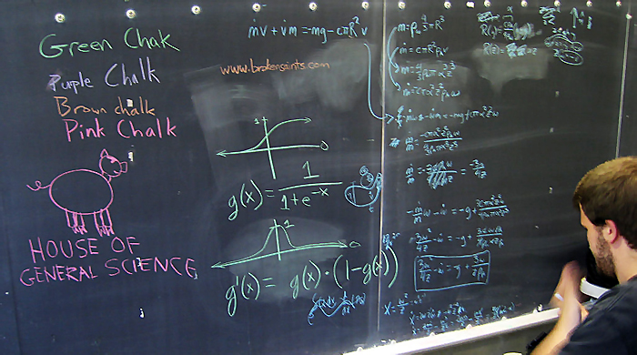
Functions in Javascript
Consider the following function
function compose(f, g) {
return function(x) {
return f(g(x));
}
}
What are the following expressions?
compose
compose(Math.sqrt, Math.abs)
compose(Math.sqrt, Math.abs)(-9)

Slide 72
Subtypes
A subtype is a type that has certain constraints placed on its values or operations. In Ada subtypes can be directly specified.
subtype one_to_ten is Integer range 1 .. 10;
type Day is (Monday, Tuesday, Wednesday, Thursday, Friday, Saturday, Sunday);
subtype Weekend is Day range Saturday .. Sunday;
type Salary is delta 0.01 digits 9 range 0.00 .. 9_999_999.99;
subtype Author_Salary is Salary digits 5 range 0.0 .. 999.99;
Are subtypes supported in Java?

